Slide 1
HTML Lists

Slide 2
List of reasons to use lists
Organize information
Simple structure
Easy to read and write
Arrange things in order
Most important
Less important
Least important
Can be about anything

Slide 3
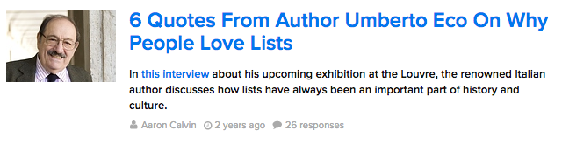
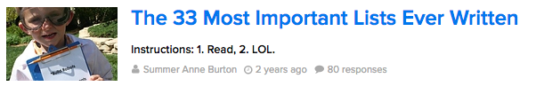
Lists are everywhere
https://en.wikipedia.org/wiki/List_of_lists_of_lists
“This article is a list of articles that are themselves lists of articles that are also lists on the English Wikipedia”

Slide 4
HTML Lists
Unordered Ordered
Item
Item
Item
Item
First item
Second item
Third item
Fourth item

Slide 5
The <ul> Tag
The <ul> tag defines an unordered list

Slide 6
The <li> Tag
The <li> tag defines a list item inside a list

Slide 7
Unordered List Example
<ul>
List content goes here
</ul>

Slide 8
Unordered List Example
<ul>
<li>Apples</li>
<li>Bananas</li>
<li>Milk</li>
<li>Bread</li>
</ul>

Slide 9
Unordered List Example
<ul>
<li>Apples</li>
<li>Bananas</li>
<li>Milk</li>
<li>Bread</li>
</ul>
Apples
Bananas
Milk
Bread
Preview

Slide 10
The <ol> Tag
The <ol> tag defines an ordered list

Slide 11
Ordered List Example
<ol>
List content goes here
</ol>

Slide 12
Ordered List Example
<ol>
<li>Apples</li>
<li>Bananas</li>
<li>Milk</li>
<li>Bread</li>
</ol>

Slide 13
Ordered List Example
<ol>
<li>Apples</li>
<li>Bananas</li>
<li>Milk</li>
<li>Bread</li>
</ol>
<li> is used regardless of what type of list we’re making!

Slide 14
Ordered List Example
<ol>
<li>Apples</li>
<li>Bananas</li>
<li>Milk</li>
<li>Bread</li>
</ol>
Apples
Bananas
Milk
Bread
Preview

Slide 15
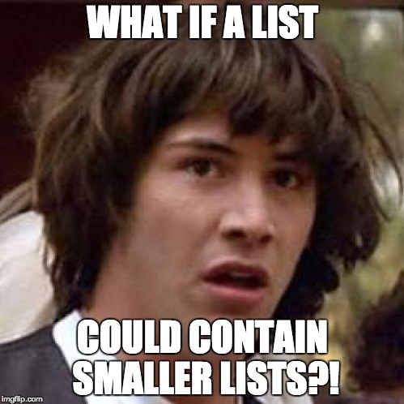
Nesting Lists

Slide 16
Nesting Lists
Apples
Cookies
Milk

Slide 17
Nesting Lists
Apples
Cookies
Chocolate Chip
Peanut butter
Milk

Slide 18
Nesting Lists
Apples
Cookies
Chocolate Chip 1. White Chocolate Chip 2. Dark Chocolate Chip
Peanut butter
Milk

Slide 19
Nesting Lists
Apples
Cookies
Chocolate Chip 1. White Chocolate Chip 2. Dark Chocolate Chip
Peanut butter
Milk
Indentation shows the nesting structure

Slide 20
Nesting Lists
<ul>
<li>Apples</li>
<li>Cookies</li>
<li>Milk</li>
</ul>
Apples
Cookies
Milk
Preview

Slide 21
Nesting Lists
<ul>
<li>Apples</li>
<li>
Cookies
<ul>
<li>Chocolate Chip</li>
<li>Peanut Butter</li>
</ul>
</li>
<li>Milk</li>
</ul>
Apples
Cookies
Chocolate Chip
Peanut Butter
Milk
Preview

Slide 22
Nesting Lists
<ul>
<li>Apples</li>
<li>
Cookies
<ul>
<li>Chocolate Chip</li>
<li>Peanut Butter</li>
</ul>
</li>
<li>Milk</li>
</ul>
Apples
Cookies
Chocolate Chip
Peanut Butter
Milk
Preview

Slide 23
Nesting Lists
<ul>
<li>Apples</li>
<li>
Cookies
<ul>
<li>Chocolate Chip</li>
<li>Peanut Butter</li>
</ul>
</li>
<li>Milk</li>
</ul>
Apples
Cookies
Chocolate Chip
Peanut Butter
Milk
Preview

Slide 24
Let’s see this in the editor!

